Slide 1
Online Intercity Car Pooling System
MAHESH GHULE
AKSHAY ATOLE
RAVINDRA DHAGE

Slide 2
content
Introduction
Admin Module
Module Diagrams
User Interfaces
Advantages
Conclusions

Slide 3
INTRODUCTION
The project “Online Intercity Car Pooling System” shows the implementation of a car pooling system. Car Pooling is defined as the sharing of a vehicle by
more than one person to reduce the cost of travel. Car sharing helps the
individual in reducing various costs such as fuel cost,stress of driving in many conditions, reduction in toll taxes.

Slide 4
Admin Module
Online car pooling system consists of three modules described as below.
1. Car owner Module.
2. User Module.
3. Admin Module.
❖ Car owner Module :
• Car owner can register and create his own account. Car owner should be able to registered by providing their personal information, vehicle details, drivers-license information and contact details.
• Online car pooling system provides the function which allows Car owner to
publish his travelling details.
• He/she is able to select existing user with their choice.

Slide 5
❖ User Module :
• User can register and create his own account.
• Online car pooling system provides the function which allows user to find out
the rides where he/she wanted to go.
• User can find out the minimum price ride and then user can send the request to particular driver.
❖ Admin Module :
• Online car pooling system should provide all function to admin how to handle
the System.
• What are the Car owner and Users are using this system and are they authorized.

Slide 6
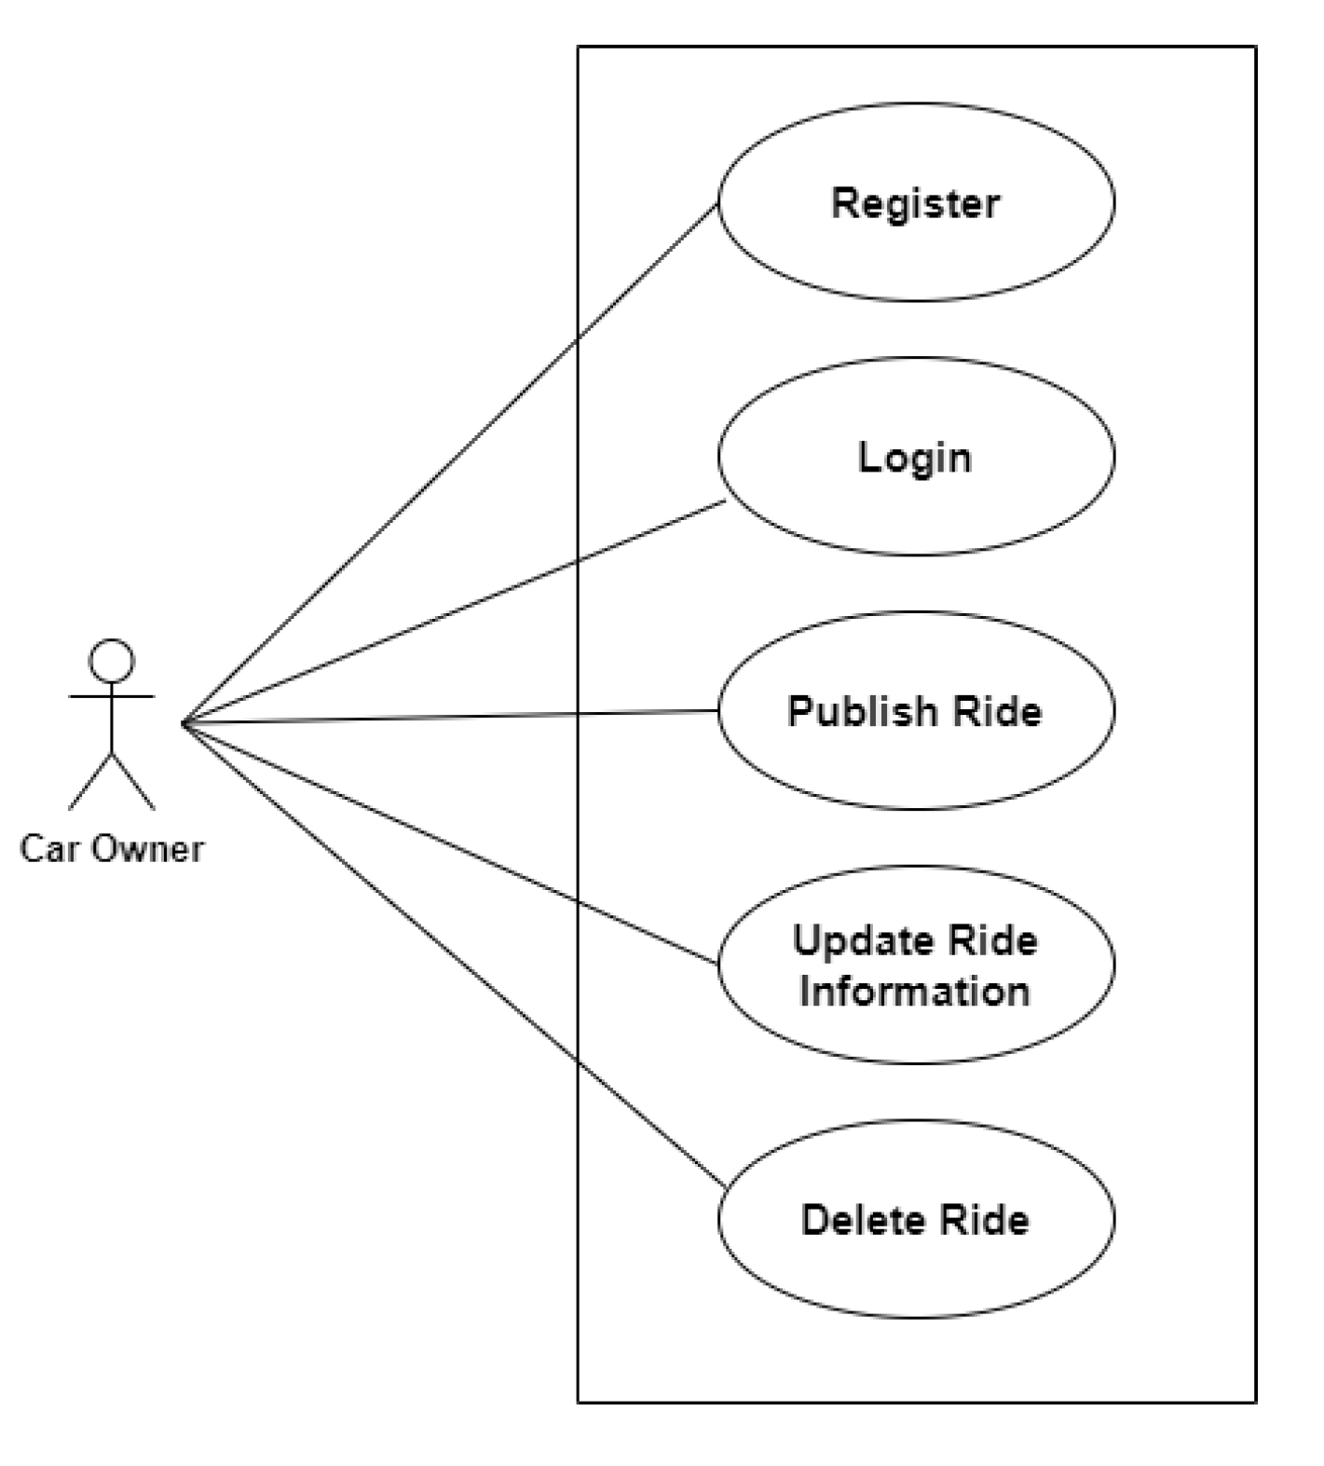

Slide 7
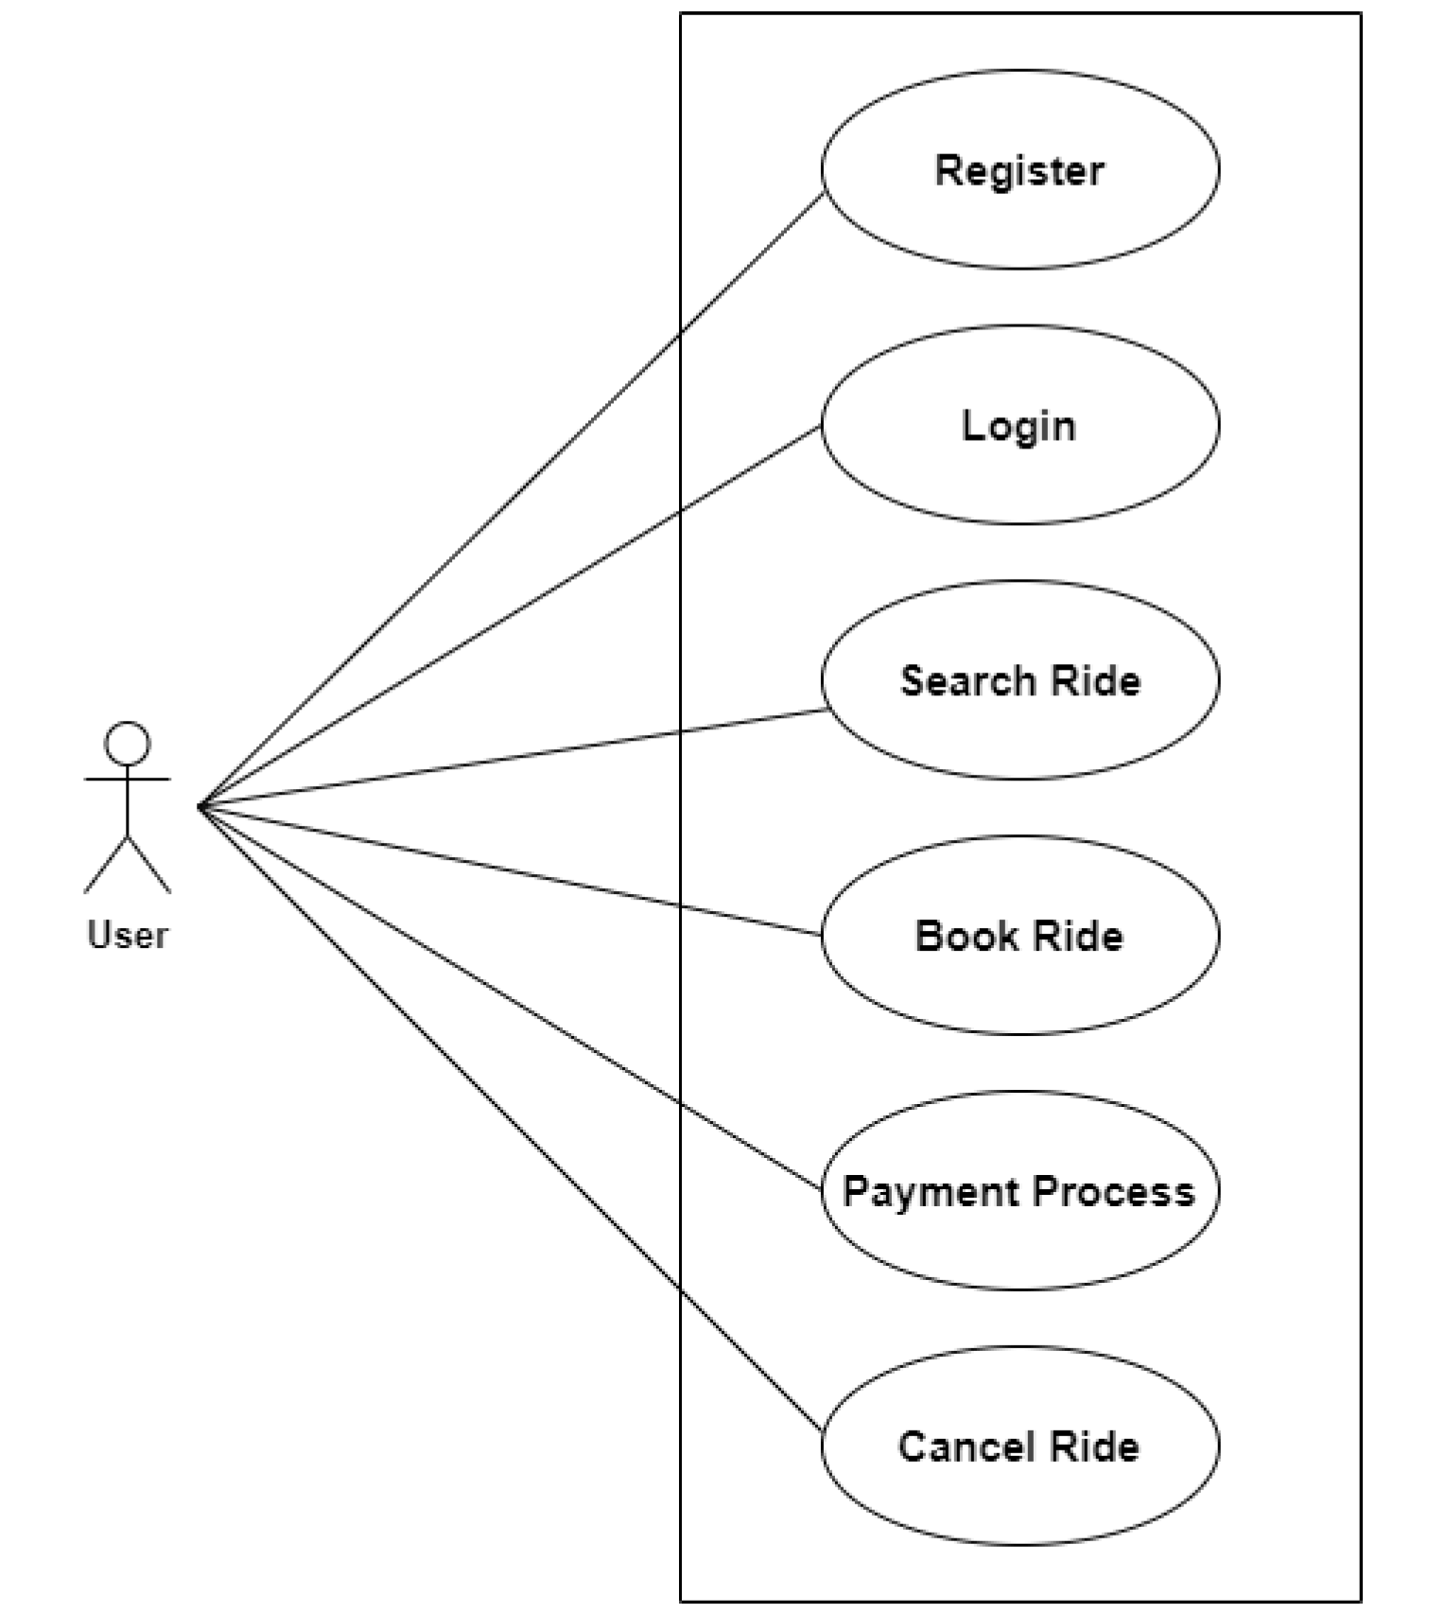

Slide 8
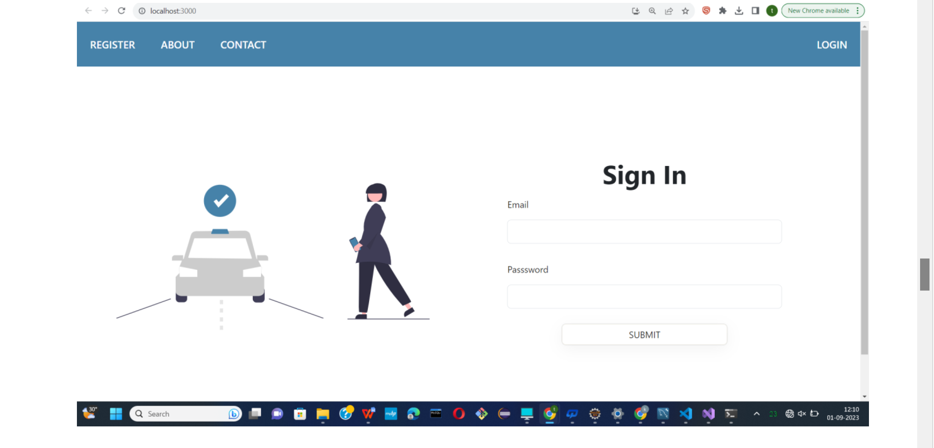
User interface design

Slide 9
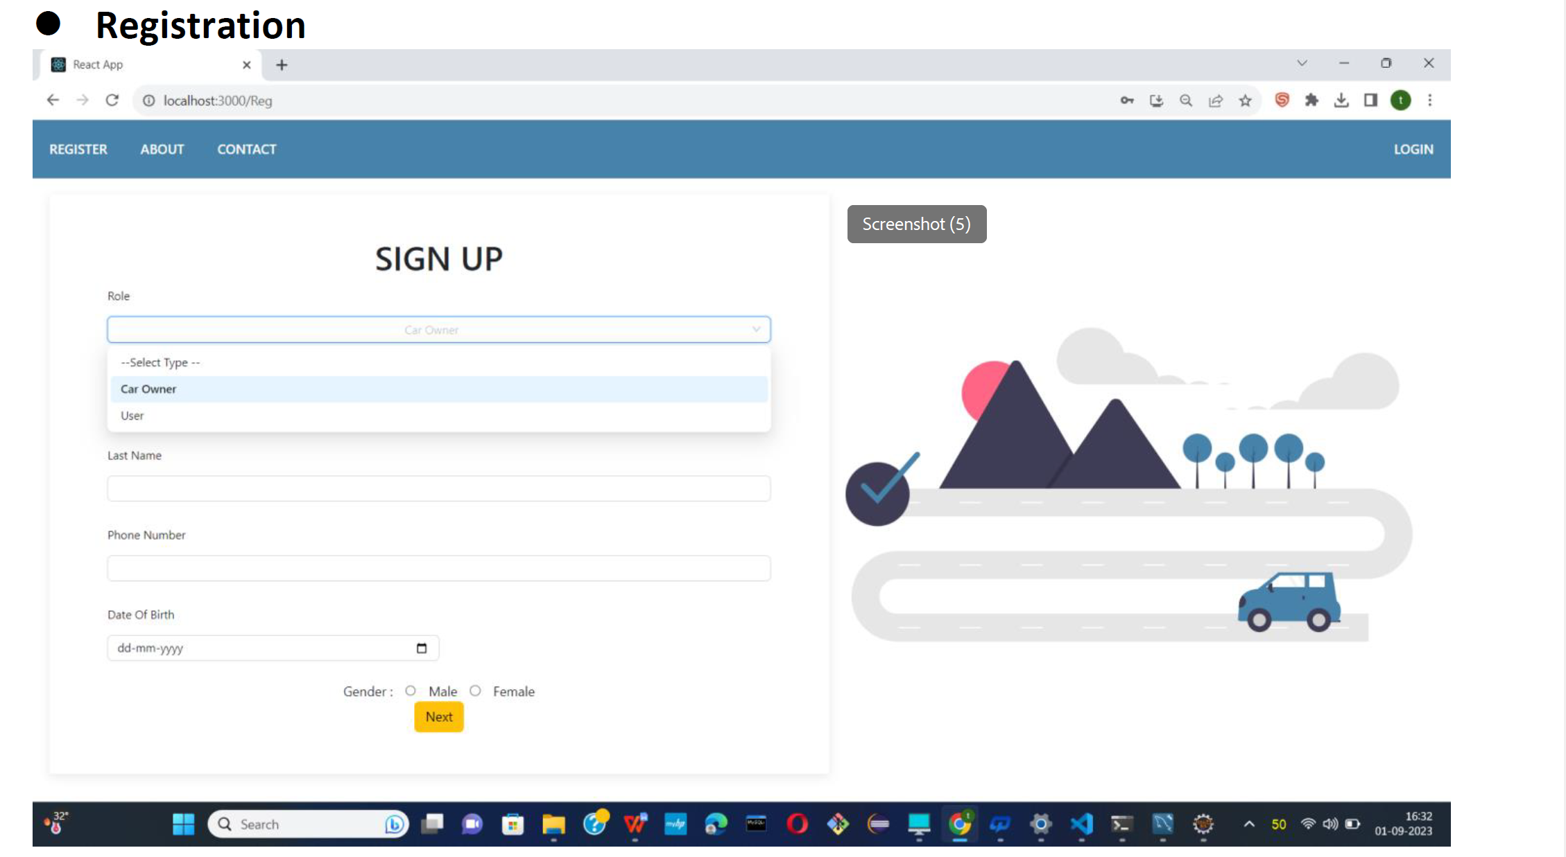

Slide 11
ADVANTAGE
Redistribution of travel costs more comfortable traveling than driving own vehicle.
Often the possibility of traveling from door to door
Less stressed travelling
Often cheaper than public transport
Opportunity to meet new people
Safety Measures
Traffic Reduction

Slide 12
CONCLUSIONS
Carpooling is the sharing of car journeys so that more than one person travels in a car, and
prevents the need for others to have to drive to a location themselves with own car.
Reduce traffic congestion – The benefits of carpooling on a large scale are huge.
The software is flexible enough to be modified and implemented as per future requirements.
We have tried our best to present this free and user–friendly website to Society.

Slide 13
THANK
YOU

